Slide 1

Our incineration plant model
A model that is based on TRIDEL data (Lausanne)

Slide 2
Plan
Quick demonstration
Program structure
Model
Results enhancement

Slide 3

Quick demonstration

Slide 4
Program structure
Script parts
Data transfers via CSVs
Self-running program
Code resilience

Slide 5
Model
Start data
Computing data
Output analysis

Slide 6
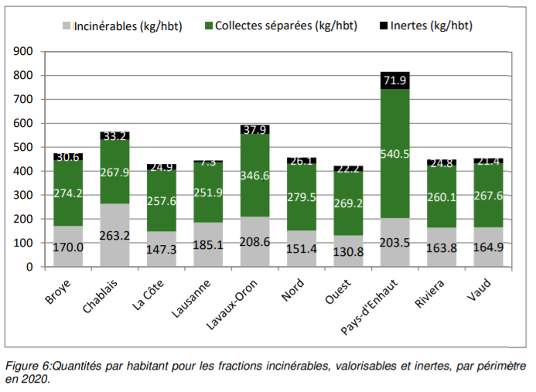
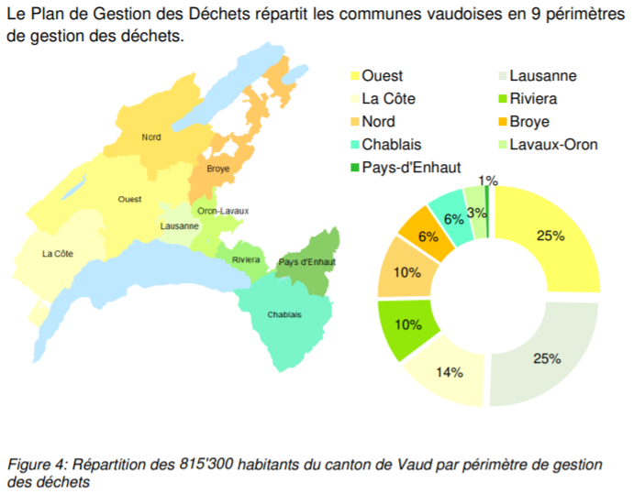
Start data

Slide 7
Computing data

Slide 8
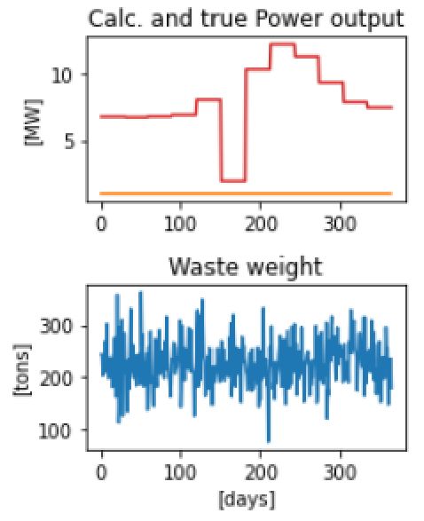
Output analysis

Slide 9
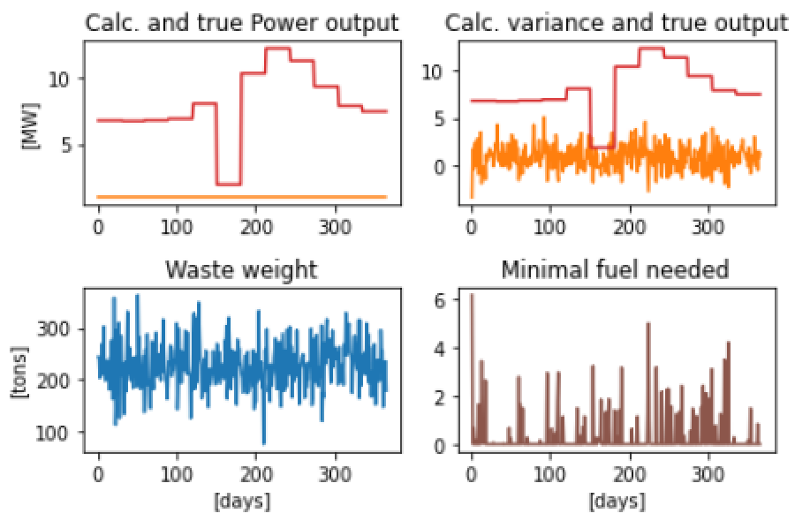
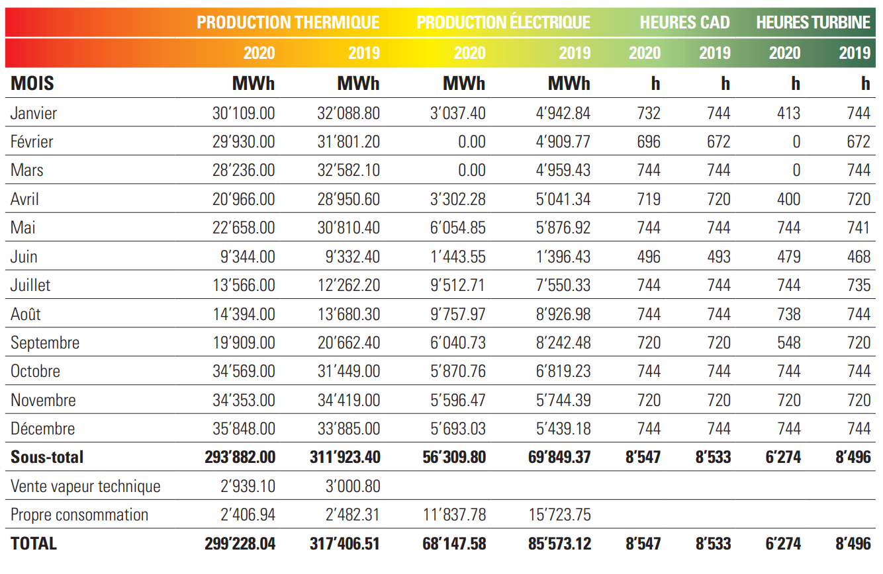
Results enhancement
Adding general variance
New data processing

